Slide 1
Kraken.Fit
Innovation does not need to be installed!
Notes:
Hi, we are team Kraken, here with a virtual health service agent to make you fitter.

Slide 2
Let’s go for a walk!
Walking keeps you healthy.
Notes:
Let me walk you through the core idea of Kraken.Fit.
Have you ever thought of going for a run or jog or walk, outdoors, to get a better and healthy lifestyle.

Slide 3
But! Where?
Notes:
But where would you walk with the environment polluted at higher toxic levels than ever that will affect your health in a very bad way. We are in a smoke, smog, pollens, trash ridden place, whose air is bad to breath and parks un-walkable.

Slide 4
Kraken.Fit
*Drum rolls pls*
Notes:
We have Kraken.Fit to our rescue. Kraken.Fit will be your best bud in your daily fitness endeavours.

Slide 5
Get Purest Routes,
With Calorie Assistance!
Notes:
Kraken fit provides you with the purest most clean routes to take a stroll without harming yourself that would have happened otherwise. The route selection takes into consideration the weather, pollen content, pollution, air quality index, time of the day and traffic data too so you get a pleasant experience and can also cycle all the way.

Slide 6
Demo

Slide 7
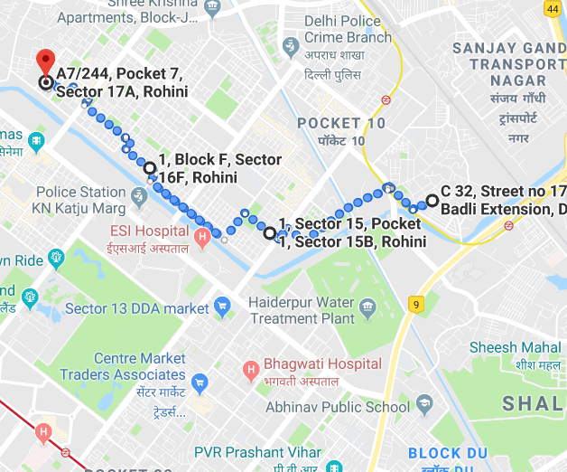
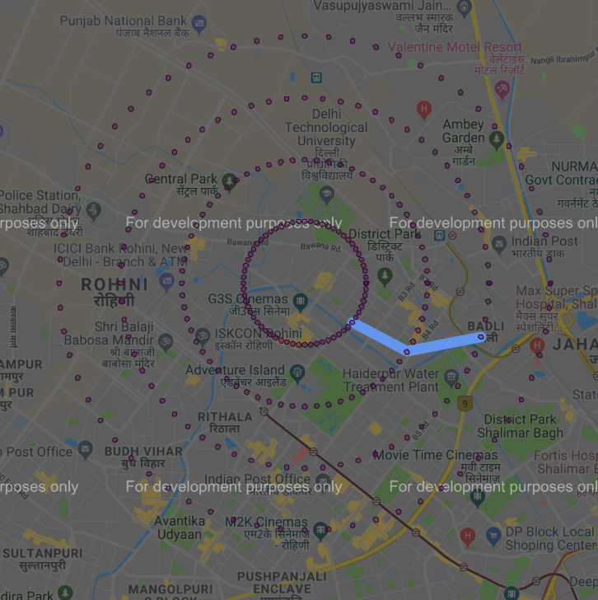
SnapShots
https://breezometer.com/air-quality-map/search?lat=28.737036599999996&lon=77.1124209
Notes:
It fetches all these data points and maps 264 waypoints in layers of 4 throughout the area based on the distance that you wanted to cover as shown. These waypoints are then filtered to find the best possible route by smartly using the path finding algorithms of Computer Science like the floyd warshall algorithm.

Slide 8
Good things
Notes:
The app is all but good, spreading even more goodness.

Slide 9
No
Installations
Yes! to UX!
Notes:
The best thing about the app is that you don’t need to install anything extra. It works off of your favourite applications, whatsapp or telegram and everyone’s go to, google maps.
We stand proud of the experience that you get. It is butter smooth.

Slide 10
0.00%
Investment!
Notes:
Time is all you need to put in.
With some dedication. Kraken will do the motivation fetching for you.

Slide 11
Health
Assistance
Notes:
Not only this, it will give you day based exercise routines.
Get you links on something you don’t understand or some exercise you don’t know.
It also takes input of the amount of calories you want to burn and gives a route accordingly.

Slide 12
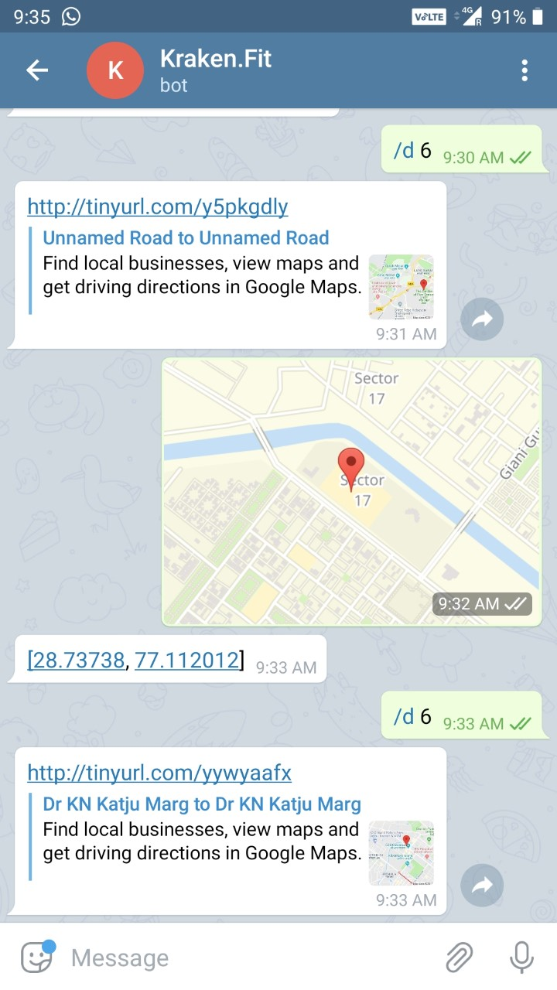
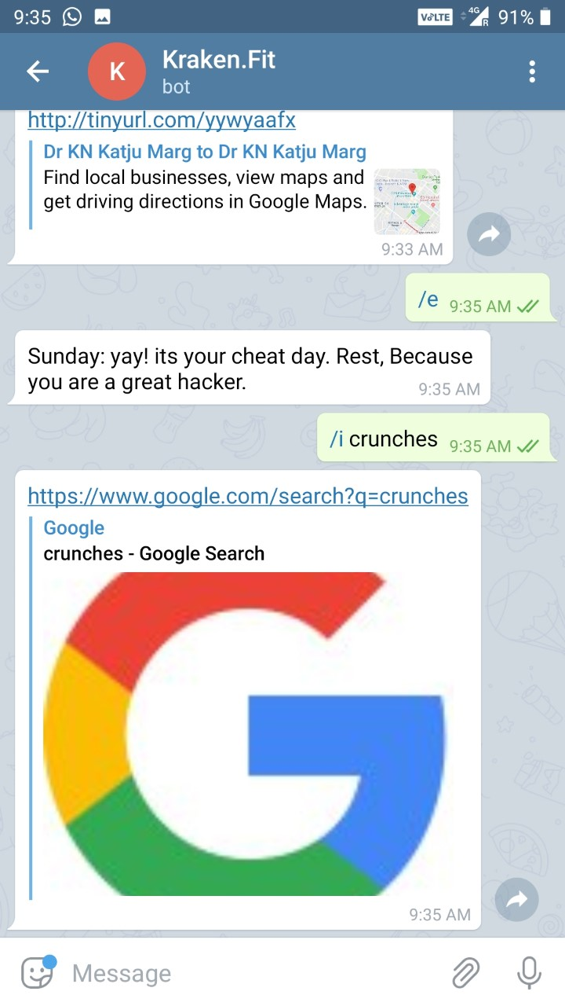
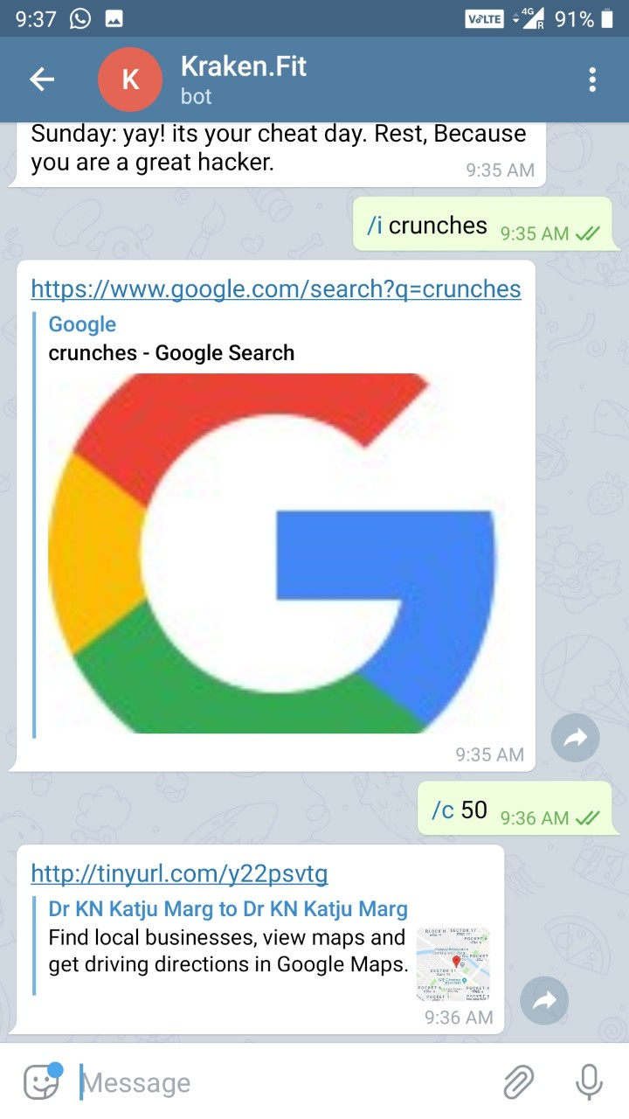
How it looks like?

Slide 13
Market Research
Notes:
There are many apps which tells you the best route according to traffic, but there is no such app which will suggest you the best route according to the air quality.

Slide 14
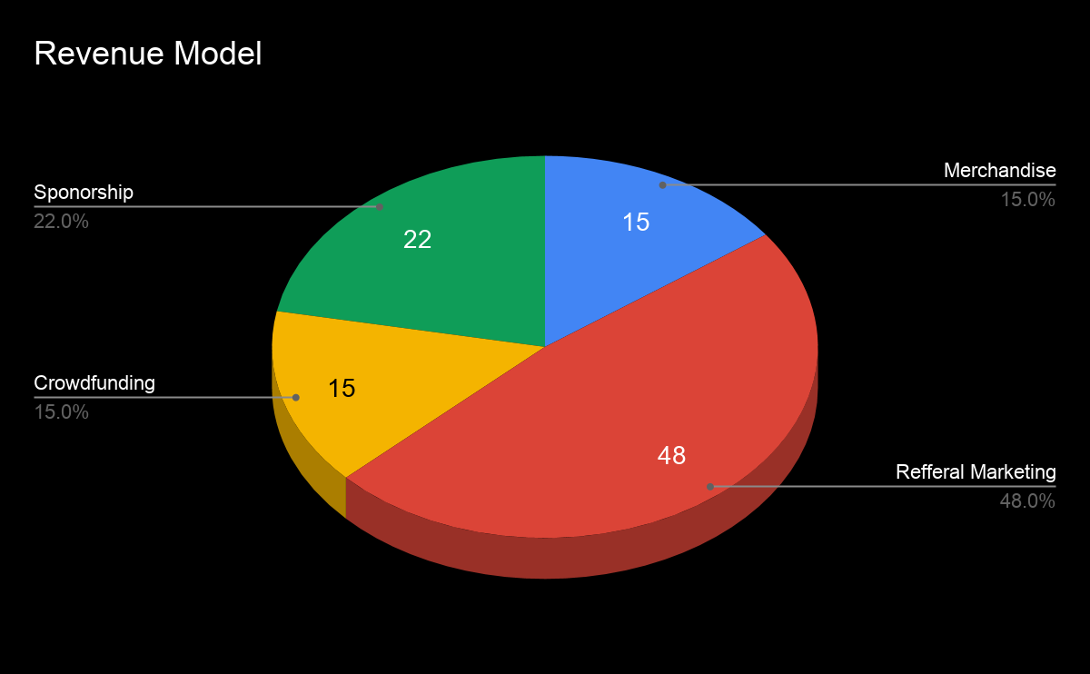
Revenue Model
Advertisement
Referral Marketing
Crowdfunding
Sponsorship
Source-https://mlsdev.com/blog/how-do-free-apps-make-money

Slide 15
Future Aspects
A Full fledged health assistant like alexas and siris of the world but oriented towards health
Leaderboard s to compete with friends
Monthly Rewards for task completions

Slide 16
Thankyou

